Slide 1
Quality of Life by Country: A Clustering Analysis
Katherine M. Prioli
MAT 8790 Final Project
December 19, 2018

Slide 2
BACKGROUND
Recent report by the Centers for Disease Control and Prevention shows decreasing life expectancy in the United States
Decline largely due to preventable diseases
With increasing globalization, it’s important to understand how United States compares to other countries on key Quality of Life (QoL) measures, including:
Life expectancy
Gender equality
Social progress
Happiness
Infant mortality
and others

Slide 3
OBJECTIVE
The objective of this study was to explore the relationships between key QoL indicators by country, with particular focus on how the United States ranks

Slide 4
METHODS

Slide 5
OVERVIEW
Three stages to the analysis:
Gather data for QoL measures of interest (various organizations) and create a country-level analytic dataset
Explore the data
Univariate descriptive statistics and visualizations
Pairwise analysis via correlation matrix
Country-level ordered bivariate plots
Top and bottom 20 countries for each QoL measure
Perform a series of k-means cluster analyses
Pairwise on QoL variables for which the US did not appear among top 20 countries
Base case k = 4
Sensitivity analysis via Shiny app

Slide 6

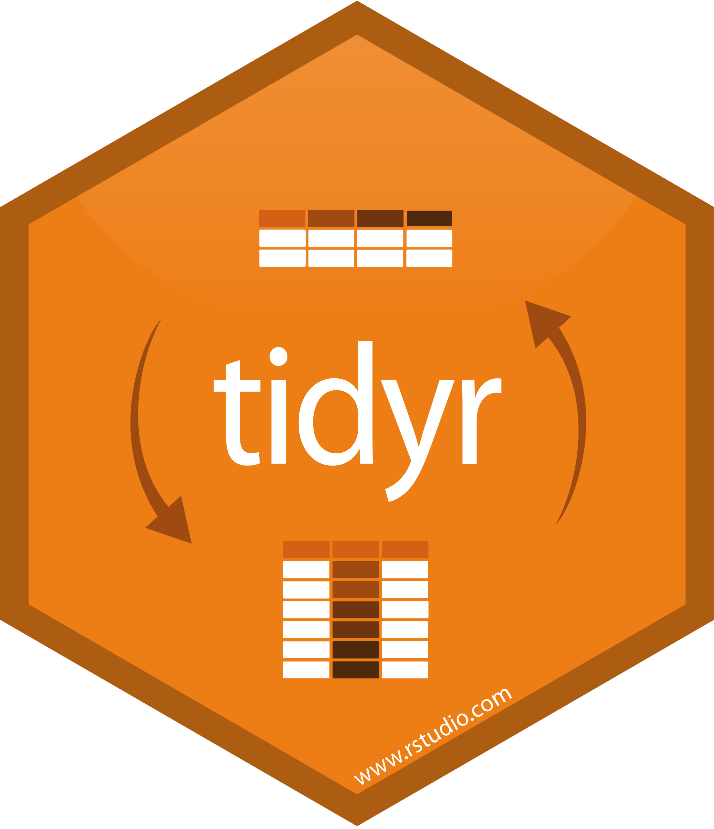





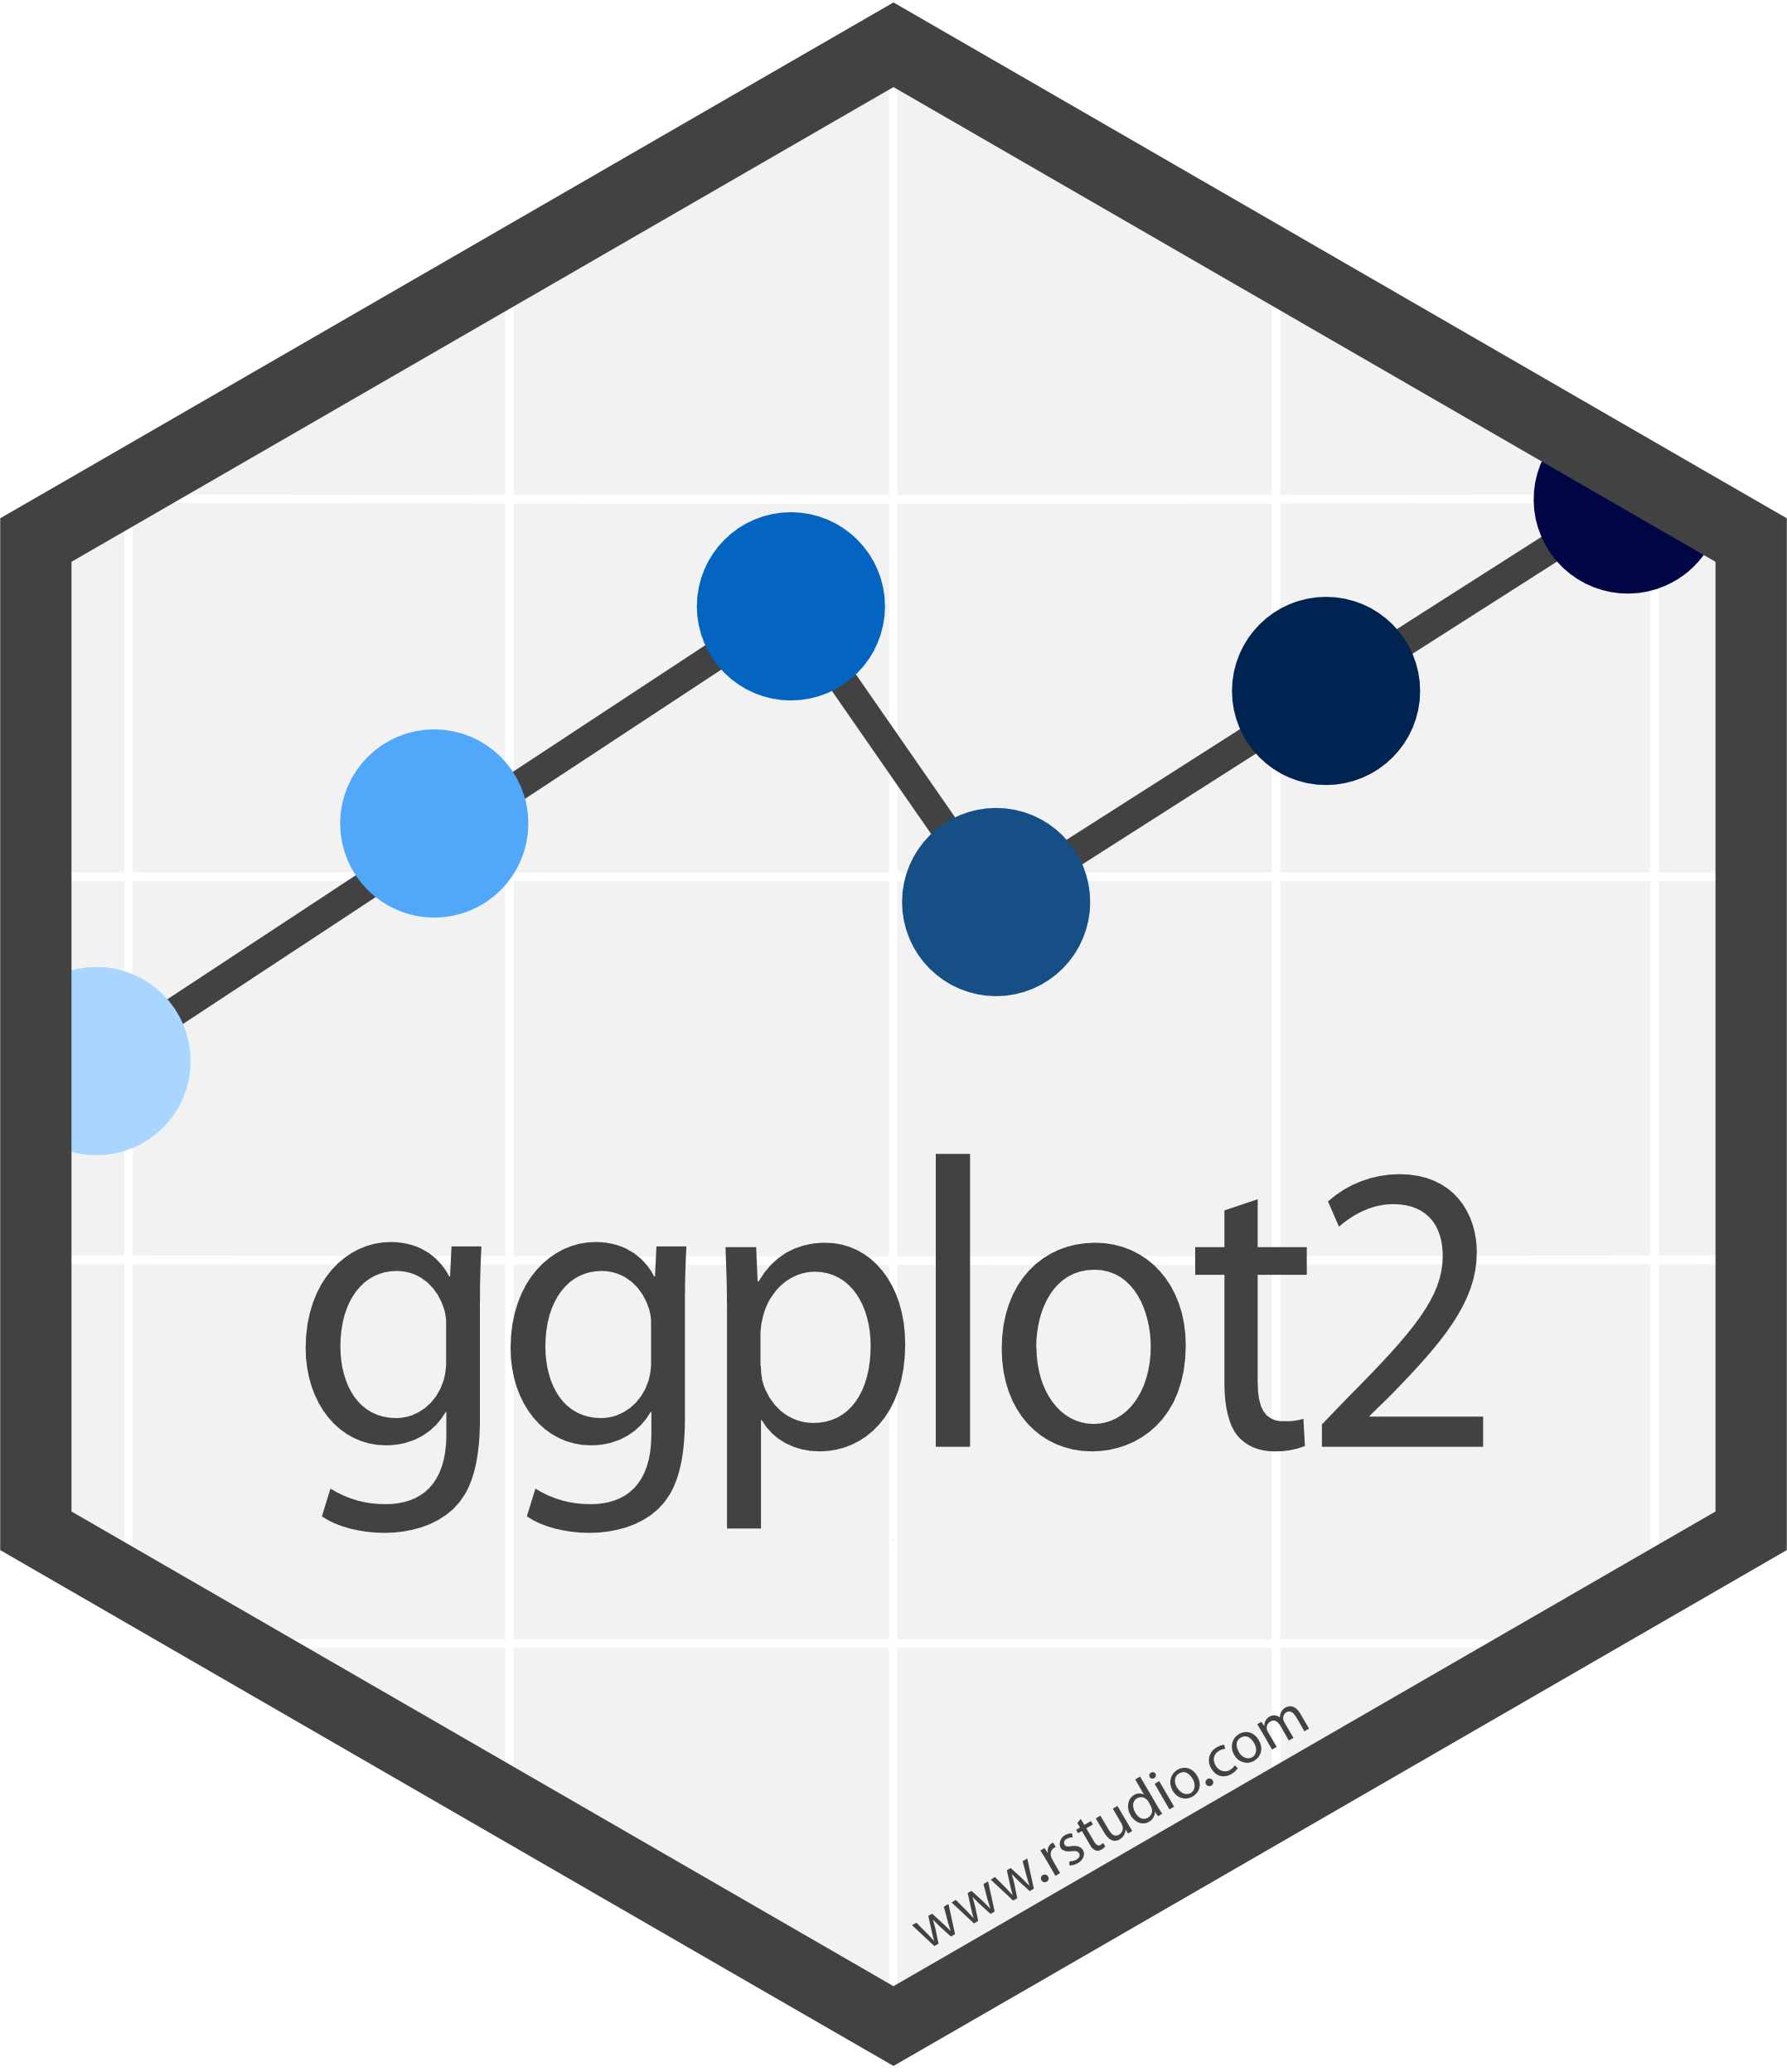

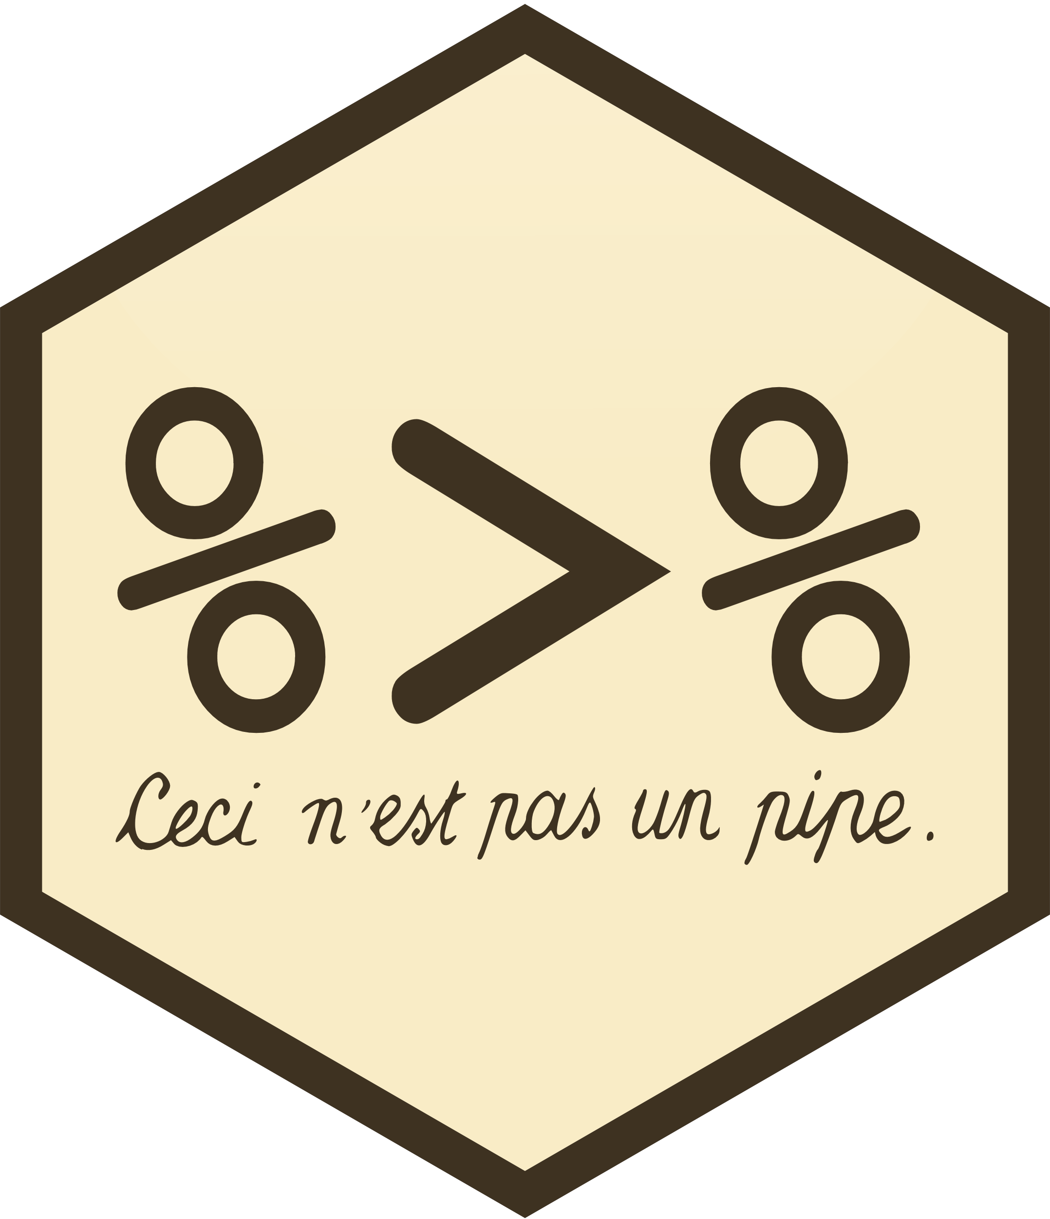
RELEVANT R PACKAGES
…and others!

Slide 7
THE DATA
VARIABLE | DESCRIPTION | SOURCE
country | Country name | countrycodes package
HDIindex | Human Development Index (compound measure, scale of 0:1); subitems include years of schooling, life expectancy at birth, and per-capita income (among others) | The United Nations Development Programme
HDI_cat | Human Development Index category (4 levels, from “low” to “very high”) | The United Nations Development Programme
SPI | Social Progress Index (compound measure, scale of 0:100); subitems include three broad categories: basic human needs (e.g., nutrition, safety), foundations of wellbeing (e.g., basic knowledge, environmental quality), and opportunity (e.g., personal rights, freedoms) | Social Progress Imperative
logGDP | Gross Domestic Product, log transform | The World Bank
happiness | World Happiness Score (compound measure, scale of 0:10); subitems include per-capita GDP, healthy life expectancy, social support, freedoms, and perception of corruption, among others | The World Happiness Report
gendereq | Gender Equality Index (compound measure, scale of 0:1); measures gender-related gaps in economic participation, education, health and survival, and political offices held, among others | World Economic Forum
infantmort | Infant mortality rate (neonatal deaths per 1,000 live births) | World Health Organization
birth_MF | Life expectancy at birth, males and females | World Health Organization
sixty_MF | Life expectancy at age 60, males and females | World Health Organization

Slide 8
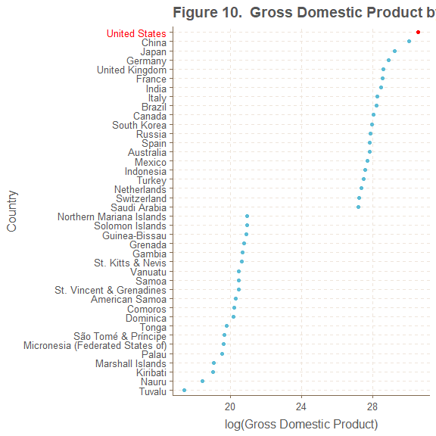
COUNTRY-LEVEL PLOTS
Gross Domestic Product by Country, Log Transform
alldata_GDP <- alldata %>%
filter(!is.na(GDP_USD_2018) == TRUE) %>%
arrange(desc(GDP_USD_2018)) %>%
select(GDP_USD_2018, country, US, color)
alldata_GDP_top20 <- alldata_GDP %>% head(20)
alldata_GDP_bot20 <- alldata_GDP %>% tail(20)
alldata_GDP_40 <- bind_rows(alldata_GDP_top20, alldata_GDP_bot20)
colors <- alldata_GDP_40$color[order(alldata_GDP_40$GDP_USD_2018)]
GDP_country_point <- ggplot(data = alldata_GDP_40,
aes(x = log(GDP_USD_2018),
y = fct_reorder(country, GDP_USD_2018),
color = US)) +
geom_point() +
scale_color_manual(values = c("US" = "#FF0000", "Non US" = "#5BBCD6")) +
theme(axis.text.y = element_text(color = colors)) +
guides(color = FALSE) +
xlab("log(Gross Domestic Product)") +
ylab("Country") +
ggtitle("Gross Domestic Product by Country, Log Transform")
GDP_country_point
Collected top and bottom 20 countries by QoL variable
Used color column to color country names
Used scale_color_manual() (contains hex codes for red for US, blue otherwise) to color geom_point()

Slide 9
K-MEANS CLUSTERING
Unsupervised learning algorithm that classifies datapoints into k groups (or “clusters”) by minimizing total within-cluster variation for all clusters
Uses function kmeans(x, k), where x is a matrix of data and k is the desired number of clusters
kmeans() is available in base R (stats package)
Useful when looking for some underlying grouping that naturally exists
In this study: bivariate data plotted in the 2D plane, suspect k = 4 groups (corresponding to 4 HDI categories, more on next slide)
Iterative process that works by:
Establishing k centroids
Classifying each point by which centroid is closest
Moving the centroids to the center of their corresponding clusters
Repeating Steps 1-3 until centroids no longer move (convergence)
Classification established by terminal iteration is the clustering
Can perform sensitivity analysis by varying k and observing what/how clusters change

Slide 10
SHINY CODE: REFRESHER AND PREAMBLE
Shiny refresher:
Apps must be named app.R
Consist of ui, server, and shinyApp() call
Data or other assets (e.g., images you want to display) live inside a www subfolder
Tasks that only occur once can be performed outside of ui and server
#### Loading libraries and data ----
library(shiny)
library(tidyverse)
library(readxl)
clusterdata <- read_csv("www/clusterdata_2018-12-09.csv")
clusterdata <- clusterdata %>%
rename(`Social Progress Index` = SPI,
`Human Development Index Rank` = HDIrank,
`Human Development Index` = HDIindex,
`Happiness Score` = happiness,
`Gender Equality Index` = genderequality_index,
`Infant Mortality Rate` = infantmort,
`Total Life Expectancy at Birth` = birth_MF,
`Total Life Expectancy at Sixty` = sixty_MF,
`Gross Domestic Product (log-transformed)` = logGDP) %>%
mutate(US_size = case_when(
US == "US" ~ 7,
TRUE ~ 3
)) %>%
mutate(HDI_cat = factor(HDI_cat,
levels = c("Low", "Medium", "High", "Very High")))

Slide 11
SHINY CODE: ui AND server
#### UI side code ----
ui <- fluidPage(
fluidRow(...,
sidebarLayout(
sidebarPanel(
selectInput(inputId = "xvar",
label = "x Variable",
choices = names(clusterdata)[5:13],
selected = names(clusterdata)[[8]]),
selectInput(inputId = "yvar",
label = "y Variable",
choices = names(clusterdata)[5:13],
selected = names(clusterdata)[[9]]),
numericInput(inputId = "clusters",
label = "Number of clusters",
value = 4,
min = 1,
max = 5)
),
mainPanel(
plotOutput(“kmeans”)
)
)
),
fluidRow(...)
)
#### Server side code ----
server <- function(input, output, session) {
selectedData <- reactive({
clusterdata[, c(input$xvar, input$yvar)]
})
clusters <- reactive({
set.seed(19811221) # Ensuring stable performance
kmeans(selectedData(), input$clusters)
})
output$kmeans <- renderPlot({
ggplot(data = selectedData(),
aes(x = selectedData()[[1]],
y = selectedData()[[2]],
color = factor(clusters()$cluster),
shape = clusterdata$HDI_cat)) +
geom_point(size = clusterdata$US_size) +
scale_color_manual(values = wes) +
scale_shape_manual(values = c(18, 17, 15, 16)) +
guides(size = FALSE,
shape = guide_legend(reverse = TRUE,
title = "HDI Category"),
color = guide_legend(title = "Cluster")) +
xlab(paste(input$xvar)) +
ylab(paste(input$yvar)) +
ggtitle("Clustering Sensitivity Analysis") +
theme(plot.title = element_text(size = 18, face = "bold"))
})
}
…then run the app by calling shinyApp(ui = ui, server = server)

Slide 12
RESULTS

Slide 13
UNIVARIATE ANALYSES

Slide 14
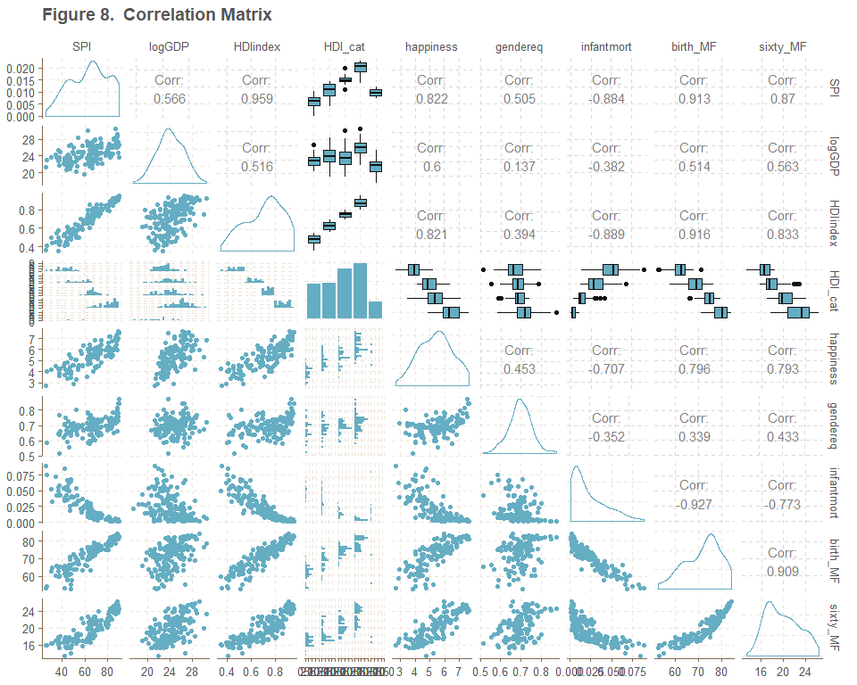
DATA EXPLORATION
Correlation Matrix
Correlation matrix generated using GGally::ggpairs()
Fastest way of visualizing pairwise relationships
Lower triangle shows scatterplots (continuous data) or grouped histograms (categorical variable), upper triangle gives correlation coefficients (continuous data) or boxplots (categorical variable)
Density plots (continuous) and bar charts (categorical) along the diagonal
Strong relationship seen between SPI and HDIindex
Strong differences in infantmort, birth_MF, and sixty_MF seen by HDI_cat

Slide 15
COUNTRY-LEVEL PLOTS
US has the world’s largest GDP, yet did not appear within top 20 performing countries for several of the QoL measures, including:
Happiness score
Gender equality index
Infant mortality rate
Total life expectancy at birth and age 60

Slide 16
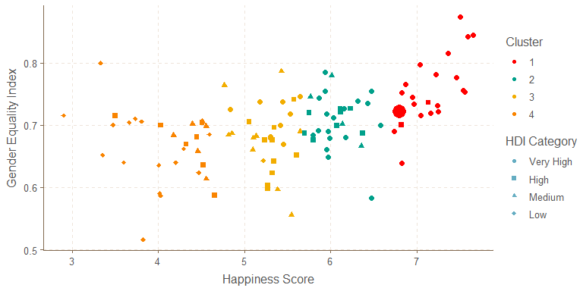
CLUSTER ANALYSES
10 cluster analyses performed
Base case considered k = 4 clusters
Relevant aesthetics:
shape() = HDI category
color() = Cluster
size() = US (large) or other countries (small)
Cluster Analysis: Gender Equality Index vs. Happiness Score

Slide 17
SENSITIVITY ANALYSIS
Sensitivity analysis on the effect of varying k on the cluster position of the United States (via Shiny app):
https://kmprioli.shinyapps.io/MAT_8790_kmeans/

Slide 18
DISCUSSION
Utility:
Limitations:
Challenges:
Surprises:
Future work:

Slide 19
REFERENCES
Helliwell, John F., Richard Layard, and Jeffrey D. Sachs. 2018. “World Happiness Report.” http://worldhappiness.report/ed/2018/.
James, Gareth, Daniela Witten, Trevor Hastie, and Robert Tibshirani. 2013. “An Introduction to Statistical Learning.” Springer. https://www-bcf.usc.edu/~gareth/ISL/.
Murphy, Sherry L., Jiaquan Xu, Kenneth D. Kochanek, and Elizabeth Arias. 2018. “Mortality in the United States, 2017. NCHS Data Brief, No 328.” National Center for Health Statistics. https://www.cdc.gov/nchs/products/databriefs/db328.htm.
Prioli, Katherine M. 2018. “MAT_8790_Final_Project.” https://github.com/kmprioliPROF/MAT_8790_Final_Project.
Social Progress Imperative. 2018. “Social Progress Index.” https://www.socialprogress.org/?tab=4.
The United Nations Development Programme. 2018. “Human Development Index.” http://hdr.undp.org/en/data.
The World Bank. 2018. “Gross Domestic Product.” https://data.worldbank.org/indicator/ny.gdp.mktp.cd?view=map&year_high_desc=true.
World Economic Forum. 2016. “Gender Equality.” http://reports.weforum.org/global-gender-gap-report-2016/rankings/.
World Health Organization. 2018a. “Life Expectancy.” http://apps.who.int/gho/data/view.main.SDG2016LEXv?lang=en.
World Health Organization. 2018b. “Probability of Dying Per 1000 Live Births.” http://apps.who.int/gho/data/view.main.182?lang=en.

Slide 20


QUESTIONS?
Full project code available on GitHub:
https://github.com/kmprioliPROF/ MAT_8790_Final_Project
K-means app available on shinyapps.io:
https://kmprioli.shinyapps.io/ MAT_8790_kmeans/

